Slide 1
Data Analysis-Superstore Sales
Submitted by : Rahul C Reji

Slide 2

Business Goal
The primary objective is to strategically segment the customer base using the RFM (Recency, Frequency, Monetary) analysis methodology. This segmentation approach will empower the company to gain a deeper understanding of its customer segments, enabling it to tailor marketing strategies and initiatives more effectively.

Slide 3
Basic Details about the Dataset
Shape: Contains 8399 rows and 12 columns(After dropping row_id)
Datatypes: After changing the Datatypes to the appropriate Datatypes:
Object - Order ID, Order Priority, Customer Name, Province, Region, Product Category, Product Sub-Category, Product Name
Int - Order Quantity, Sales
Date - Order Date, Month Year
The Dataset contains the details of the orders from 01-01-2009 to 30-12-2012
The order details are from 13 Canadian Provinces
The product category includes 3 categories - Office Supplies, Furniture, Technology
795 unique customers made 5496 Orders

Slide 4
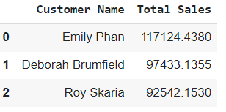
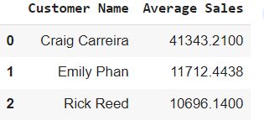
Exploratory Data Analysis
1) Sum of Sales and Average of Sales per Customer
Top 3 Sum of Sales
Top 3 Average Sales
Emily Phan is the highest in terms of Total Sales
Craig Carreira is in the top of Average Sales
This difference is due to the reason that Emily phan have ordered more times than Craig Carreira

Slide 5
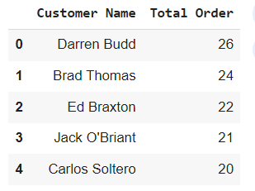
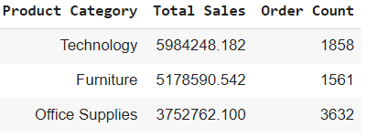
2) Total Orders per customer
Top 4 Customers Who have, High Frequency in Order
Darren Budd made the highest number of orders.
This shows that frequency for this customer is very high
3) Transaction Size and number of orders by product category
Customers ordered more in Technology Category.
Same Category made the highest sales

Slide 6
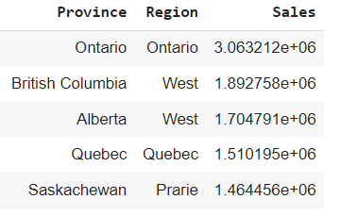
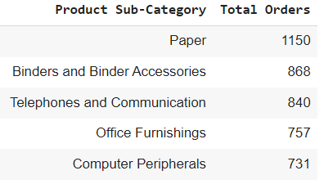
4) Total Sales by Province and Region
Top 5 Regions which made highest sales
Ontario region in Ontario province made the highest sales
5) Number of Orders by Sub-Category
Customers Ordered Paper items a greater number of times

Slide 7
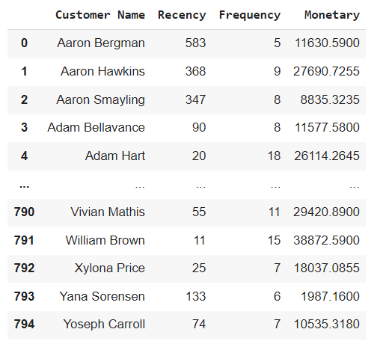
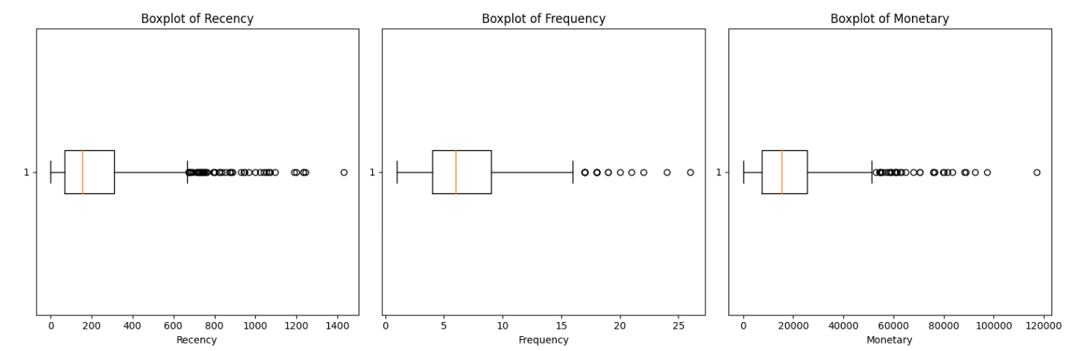
Used Order Date, Order ID, and Sales for creating RFM
RFM(Recency, Frequency, Monetary)
Recency, Frequency and Monetary contained outliers (Removed using statistical methods)

Slide 8
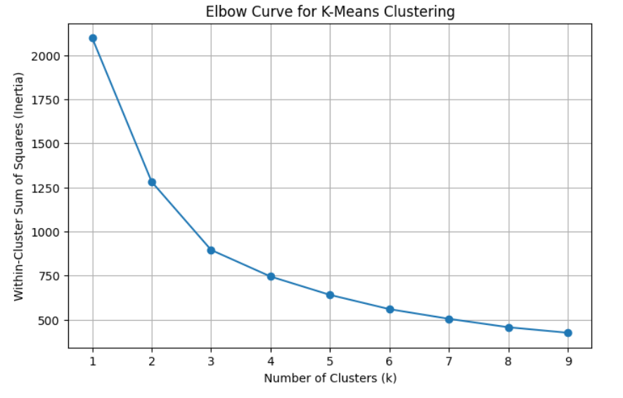
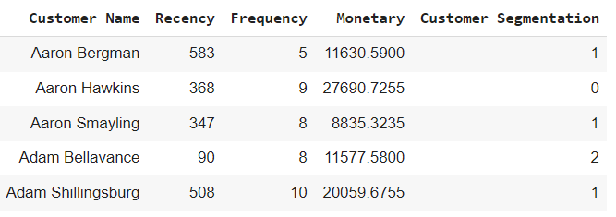
The Data was scaled using Standard Scaling
Elbow Curve and Silhouette Analysis was used to find K (cluster number)
Model Building
(K-Means)
Took number of clusters as 3
The labels were added with RFM

Slide 9
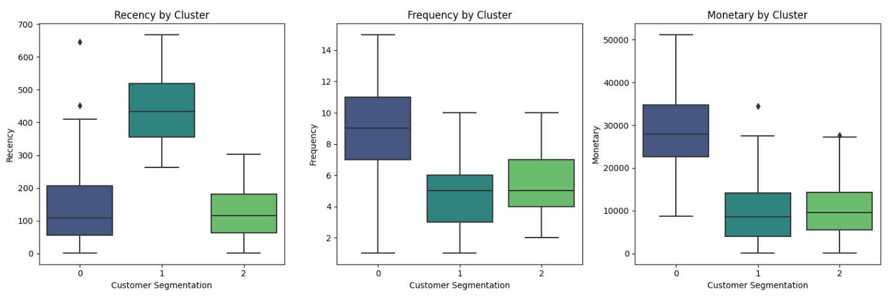
Explaining the different customer segments
Between Recency and clusters
Between Frequency and clusters
Between Monetary and clusters
Cluster 0 - Less Recency, Largest Frequency, and Largest Monetary
Cluster 2 - Lowest Recency, Moderate Frequency, and Low Monetary
Cluster 1 - Highest Recency, Lowest Frequency, and Lowest Monetary

Slide 10
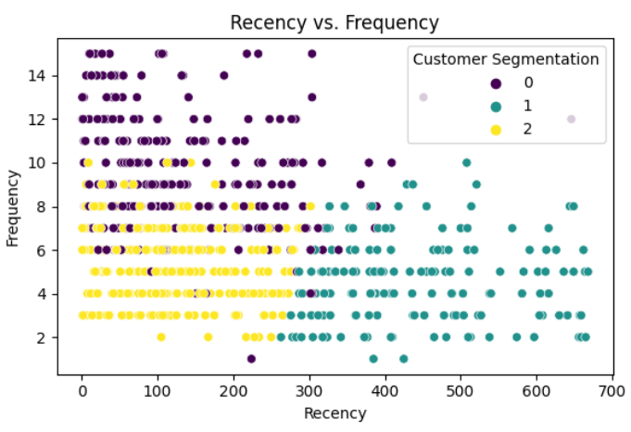
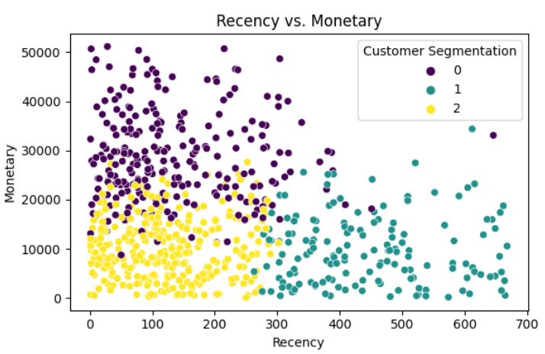
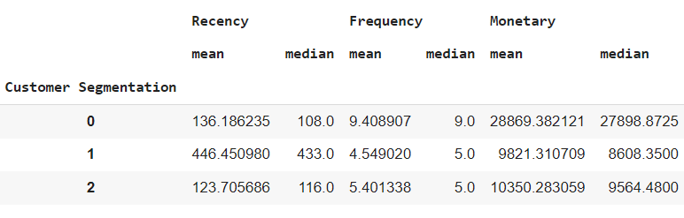
Verify the Results using Scatter plot and Cluster Statistics
Between Recency and Frequency for each clusters
Between Recency and Monetary for each clusters

Slide 11
Cluster Designation Based on Properties:
Cluster 0: High-Value Customers
Reasoning: Cluster 0 consists of customers with less recency, the largest frequency, and the largest monetary value, indicating they are high-value customers for the business.
Cluster 2: Moderate-Value Customers
Reasoning: Cluster 2 includes customers with the lowest recency, moderate frequency, and low monetary value, suggesting they are of moderate value to the business.
Cluster 1: Low-Value Customers
Reasoning: Cluster 1 comprises customers with the highest recency, the lowest frequency, and the lowest monetary value, indicating they are low-value customers for the business.

